Slide 1
Fear Forgets God
1 Samuel 21

Slide 2
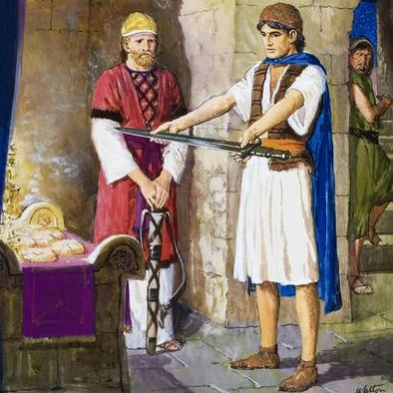
Ahimelech afraid.
When life comes at you, what do you do?
Run to the Lord!

Slide 3
Proverbs 18:10 The name of the LORD is a strong tower: the righteous runneth into it, and is safe.
1 Samuel 22:9-10 Then answered Doeg the Edomite, which was set over the servants of Saul, and said, I saw the son of Jesse coming to Nob, to Ahimelech the son of Ahitub. 10 And he enquired of the LORD for him, and gave him victuals, and gave him the sword of Goliath the Philistine.

Slide 4
Ahimelech afraid.
When life comes at you, what do you do?
Run to the Lord!
The last time Ahimelech saw any government official seeking out the priesthood was years ago!
Ahimelech = “My brother is king“
His brother worked for Saul.

Slide 5
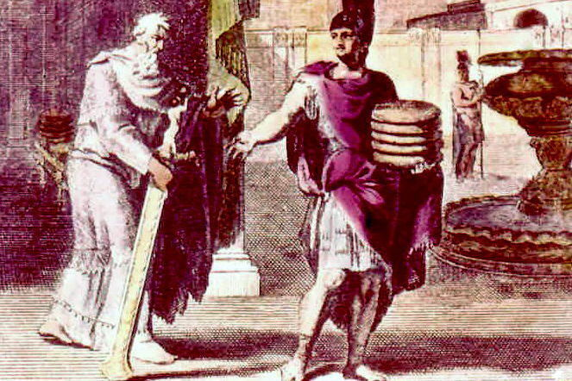
David lying
Why lie?
  Protection?

Slide 6
Isaiah 40:31 But they that wait upon the LORD shall renew their strength; they shall mount up with wings as eagles; they shall run, and not be weary; and they shall walk, and not faint.
1 Samuel 22:22 And David said unto Abiathar, I knew it that day, when Doeg the Edomite was there, that he would surely tell Saul: I have occasioned the death of all the persons of thy father's house.
Psalm 119:28-29 My soul melteth for heaviness: strengthen thou me according unto thy word.

Slide 7
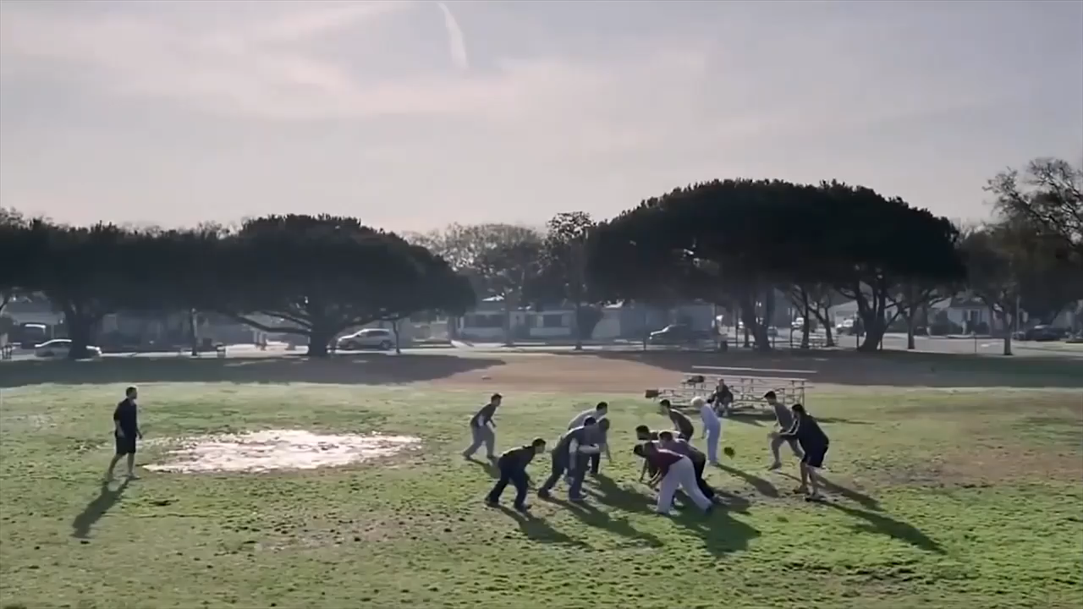
Principle: You’re not really you when you’re hungry!

Slide 8
David lying
Why lie?
  Protection?
  Hunger?
12 loves of shewbread.
One for each tribe of Israel.

Slide 9
Leviticus 24:5-9 And thou shalt take fine flour, and bake twelve cakes thereof: two tenth deals shall be in one cake. 6 And thou shalt set them in two rows, six on a row, upon the pure table before the LORD. 7 And thou shalt put pure frankincense upon each row, that it may be on the bread for a memorial, even an offering made by fire unto the LORD. 8 Every sabbath he shall set it in order before the LORD continually, being taken from the children of Israel by an everlasting covenant. 9 And it shall be Aaron's and his sons'; and they shall eat it in the holy place: for it is most holy unto him of the offerings of the LORD made by fire by a perpetual statute.

Slide 10
Principle: We need a FRESH relationship with God.

Slide 11
Luke 4:4 And Jesus answered him, saying, It is written, That man shall not live by bread alone, but by every word of God.
Luke 11:3 Give us day by day our daily bread.

Slide 12
Mark 2:23-28 And it came to pass, that he went through the corn fields on the sabbath day; and his disciples began, as they went, to pluck the ears of corn. 24 And the Pharisees said unto him, Behold, why do they on the sabbath day that which is not lawful? 25 And he said unto them, Have ye never read what David did, when he had need, and was an hungred, he, and they that were with him? 26 How he went into the house of God in the days of Abiathar the high priest, and did eat the shewbread, which is not lawful to eat but for the priests, and gave also to them which were with him? 27 And he said unto them, The sabbath was made for man, and not man for the sabbath: 28 Therefore the Son of man is Lord also of the sabbath.

Slide 13
Principle: Sometimes we must minister to a hot mess!

Slide 14
Psalm 82:3 Defend the poor and fatherless: do justice to the afflicted and needy.
Acts 20:35 I have shewed you all things, how that so labouring ye ought to support the weak, and to remember the words of the Lord Jesus, how he said, It is more blessed to give than to receive.
Romans 15:1 We then that are strong ought to bear the infirmities of the weak, and not to please ourselves.

Slide 15
Galatians 6:2 Bear ye one another's burdens, and so fulfil the law of Christ.
Hebrews 13:3 Remember them that are in bonds, as bound with them; and them which suffer adversity, as being yourselves also in the body.

Slide 16
Principle: We lay down our lives in our service to the Lord and His people.

Slide 17

David’s fear.
Doeg belonged to Saul.
Chapt 22: Doeg, at wicked Saul’s command, murdered 85 priests, he murdered their entire city of Nob – women children, babies… Deog was a monster.
Edomite ~ “flesh”
Notice! “detained before the Lord”

Slide 18
Job 1:6 Now there was a day when the sons of God came to present themselves before the LORD, and Satan came also among them.

Slide 19
Acts 20:27-30 For I have not shunned to declare unto you all the counsel of God. 28 Take heed therefore unto yourselves, and to all the flock, over the which the Holy Ghost hath made you overseers, to feed the church of God, which he hath purchased with his own blood. 29 For I know this, that after my departing shall grievous wolves enter in among you, not sparing the flock. 30 Also of your own selves shall men arise, speaking perverse things, to draw away disciples after them.

Slide 20
Principle: Doeg is here.
Doeg is in every church.

Slide 21
Principle: Fear makes you forget God’s promises!

Slide 22
Joshua 1:9 Have not I commanded thee? Be strong and of a good courage; be not afraid, neither be thou dismayed: for the LORD thy God is with thee whithersoever thou goest.

Slide 23
David’s fear.
Doeg belonged to Saul.
The sword of Goliath.
Where is David’s faith?

Slide 24
Psalm 20:7Some trust in chariots, and some in horses: but we will remember the name of the LORD our God.
Isaiah 31:1 Woe to them that go down to Egypt for help; and stay on horses, and trust in chariots, because they are many; and in horsemen, because they are very strong; but they look not unto the Holy One of Israel, neither seek the LORD!

Slide 25
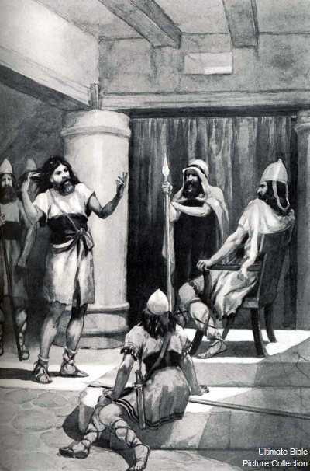
David’s fear.
Doeg belonged to Saul.
The sword of Goliath.
Where is David’s faith?
David was afraid of Saul.
Gath was afraid of David!
David was afraid of Gath’s king.

Slide 26
Psalm 37:23-24 The steps of a good man are ordered by the LORD: and he delighteth in his way. 24 Though he fall, he shall not be utterly cast down: for the LORD upholdeth him with his hand.
Psalm 33:18-22 Behold, the eye of the LORD is upon them that fear him, upon them that hope in his mercy; 19 To deliver their soul from death, and to keep them alive in famine. 20 Our soul waiteth for the LORD: he is our help and our shield. 21 For our heart shall rejoice in him, because we have trusted in his holy name. 22 Let thy mercy, O LORD, be upon us, according as we hope in thee.

Slide 27
Principle: God will deliver His people!

Slide 28
Isaiah 41:10 Fear thou not; for I am with thee: be not dismayed; for I am thy God: I will strengthen thee; yea, I will help thee; yea, I will uphold thee with the right hand of my righteousness.
1 Corinthians 10:13 There hath no temptation taken you but such as is common to man: but God is faithful, who will not suffer you to be tempted above that ye are able; but will with the temptation also make a way to escape, that ye may be able to bear it.

Slide 29
2 Timothy 4:18 And the Lord shall deliver me from every evil work, and will preserve me unto his heavenly kingdom: to whom be glory for ever and ever. Amen.
2 Peter 2:9 The Lord knoweth how to deliver the godly out of temptations, and to reserve the unjust unto the day of judgment to be punished:

Slide 30
Principle: Fear makes you crazy.
2 Timothy 1:7 For God hath not given us the spirit of fear; but of power, and of love, and of a sound mind.

